Slide 1
Multi-Model Framework for Toxic Comment Classification
Presented By:
Rajvi Gandhi
334427464
Ramya Rajan
636547507
Darsh Shah
547308192
Saurabh Borsiwala
357095572
Sudharshan Krishnamurthy
925615183

Slide 2
Introduction
In today's digital landscape, online mediums are vital for public discourse. However, the prevalence of toxic language hampers constructive dialogue and user safety. Our project introduces a Multi-Modal Framework for Toxic Comment Classification, leveraging advanced NLP techniques to identify and classify toxic remarks.

Slide 3
Work Plan
Data Collection
Model Evaluation
1
Data preprocessing
6
2
Feature Engineering
Exploratory Data Analysis
5
3
Model Development
4

Slide 4
Data Collection
The datasets used were a combination of publicly available datasets from Kaggle and Github.
The dataset contains text/comments from various social media platforms.
The Github dataset contains comments with multiple labels, each for a unique type of toxicity. For ex: Insult, threat, hate, bullying, etc.
The Kaggle dataset contains comments with a probability score of toxicity ranging from 0 to 1. Score of 0.5 or greater are labeled as toxic while the rest are labeled as non-toxic.

Slide 5
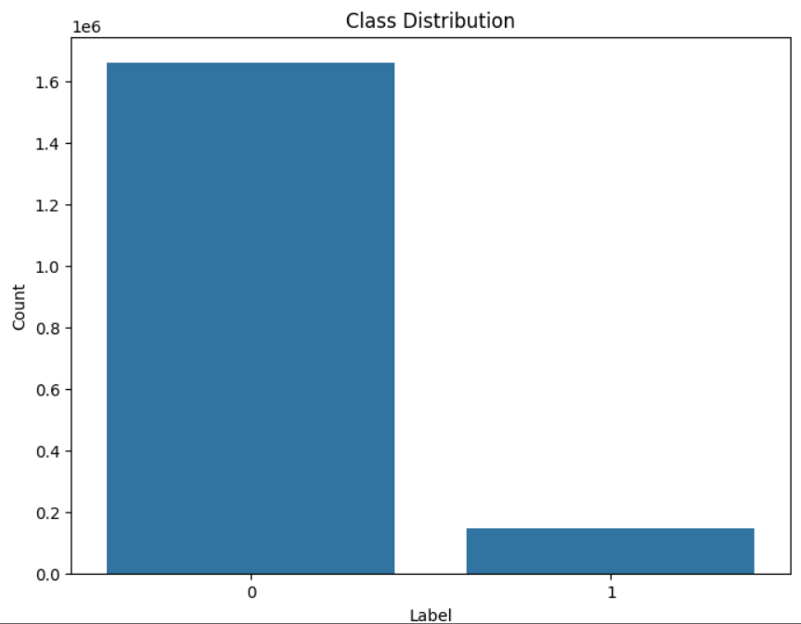
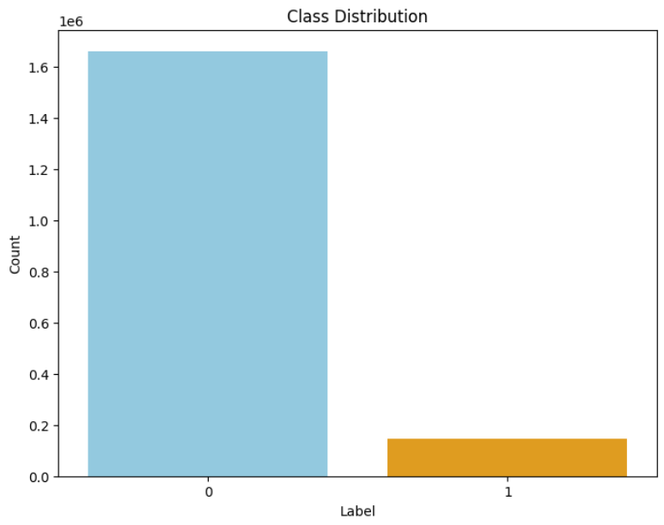
Data Collection
Since there were a lot of disparity between positive and negative comments, random positive comments were removed to balance out the data.
The combined dataset consists of around 400,000 comments with labels 0 and 1. Zero for positive and one, for negative comments.

Slide 6
Data preprocessing
A 5-step process was used to preprocess the dataset:
Removal of punctuation and capitalization: Cleanse and normalize text by converting to lowercase, removing URLs, white spaces etc with a single space.
Tokenization: Divide the cleaned text into individual words or tokens.
Removal of Stopwords: Enhance analysis by eliminating common words that do not contribute significantly to the overall meaning.

Slide 7
Data preprocessing
A 5-step process was used to preprocess the dataset:
Stemming: Simplify words to their root form for enhanced analysis.
Lemmatization: Enhance text normalization and analysis by reducing words to their base or dictionary form.

Slide 8
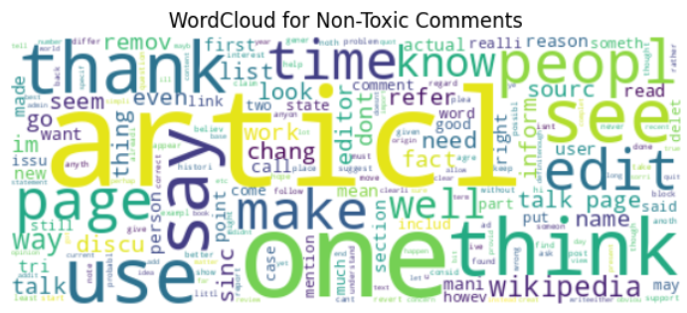
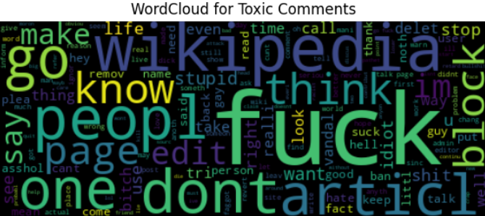
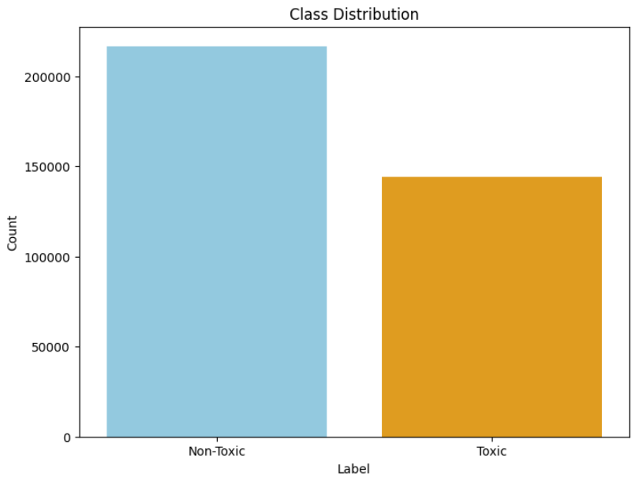
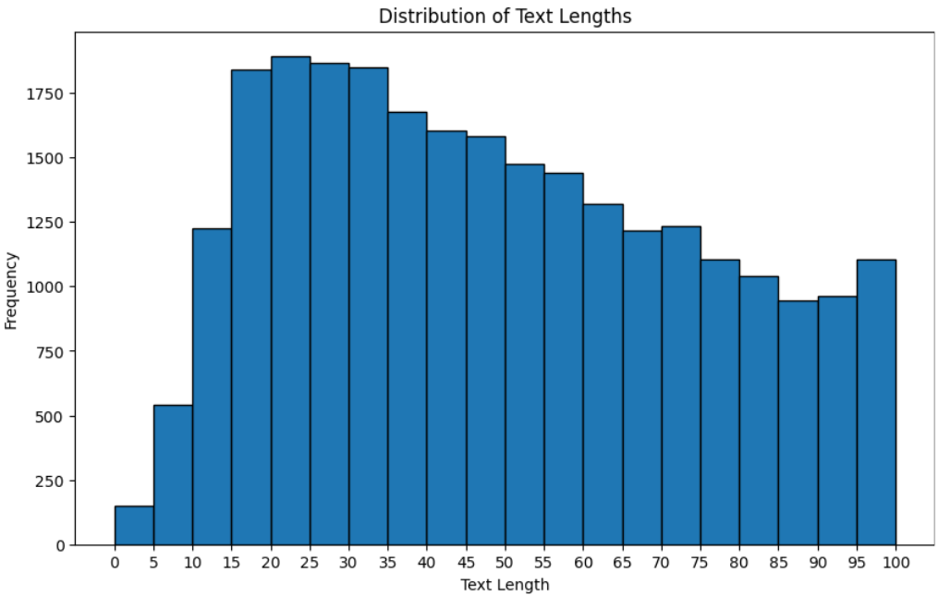
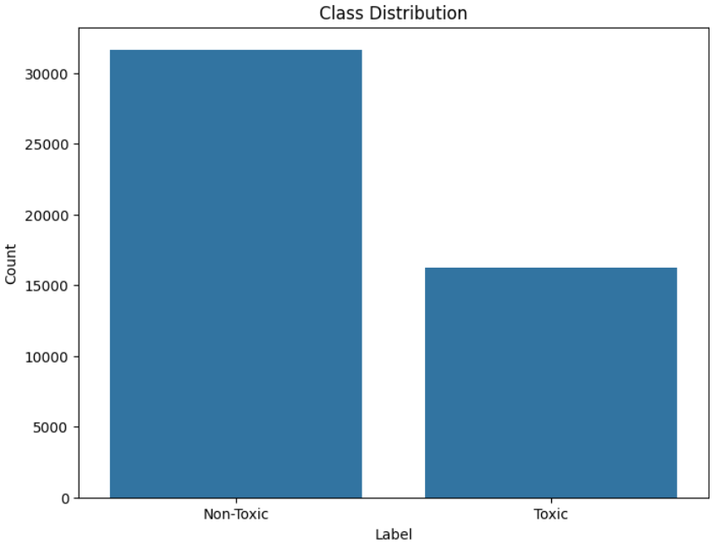
Exploratory Data Analysis

Slide 9
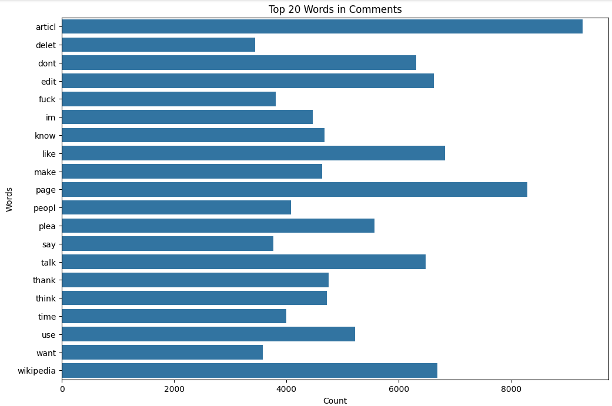
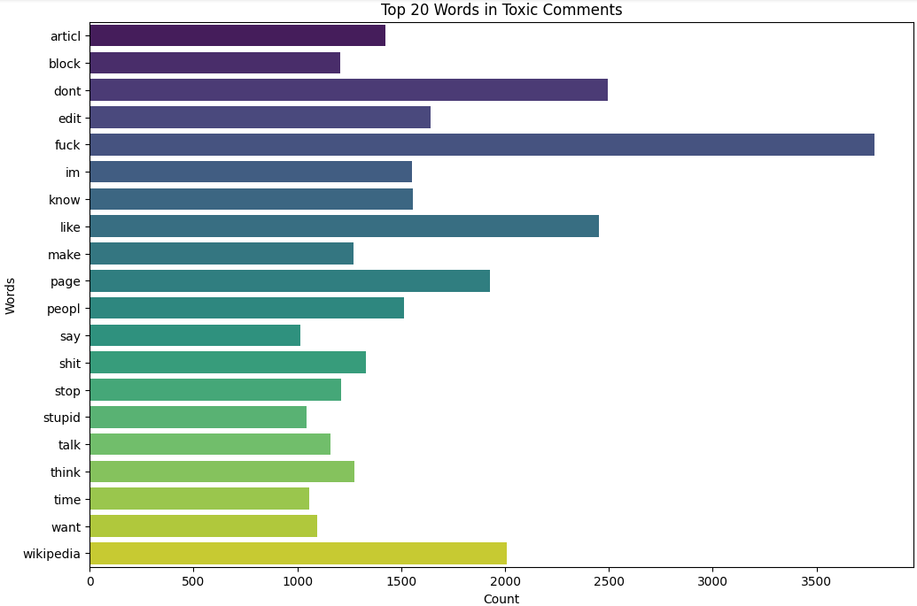
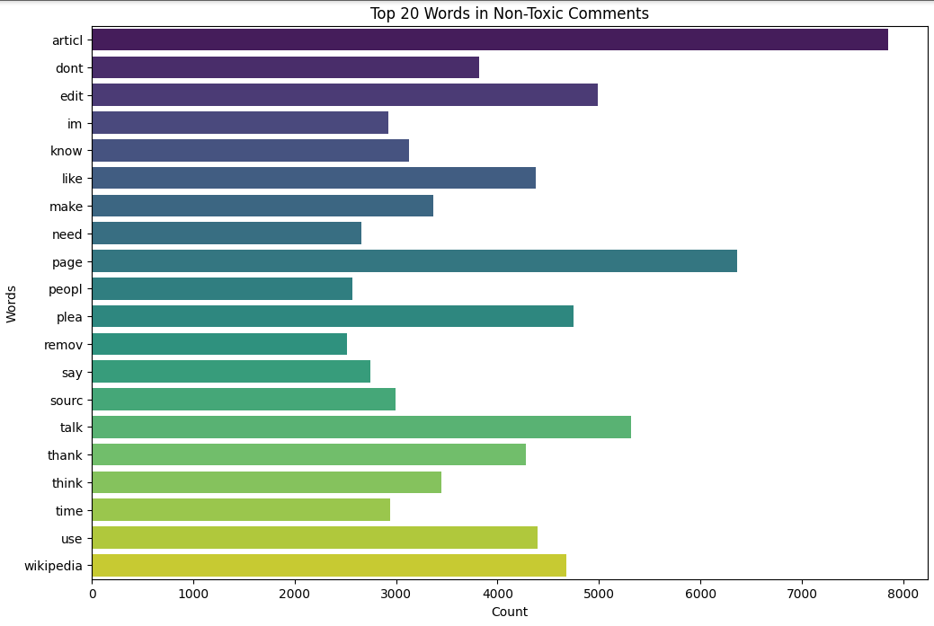
Exploratory Data Analysis

Slide 10
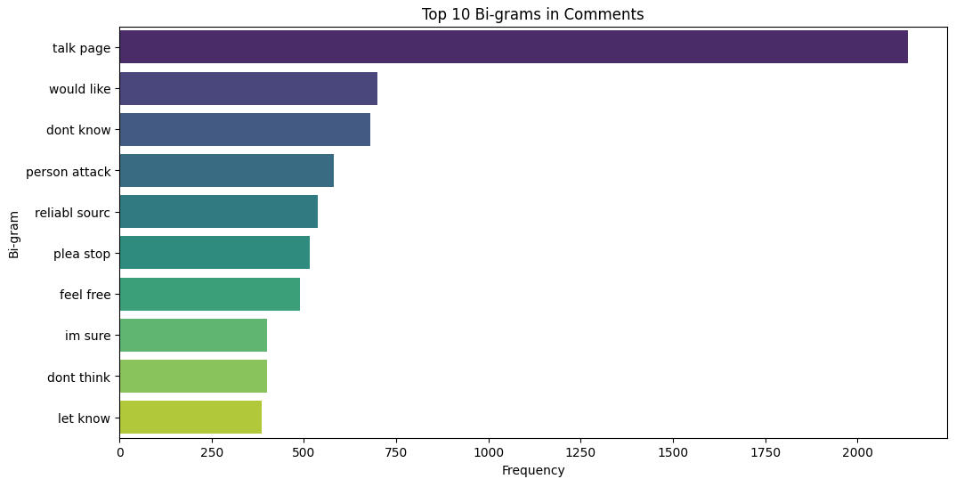
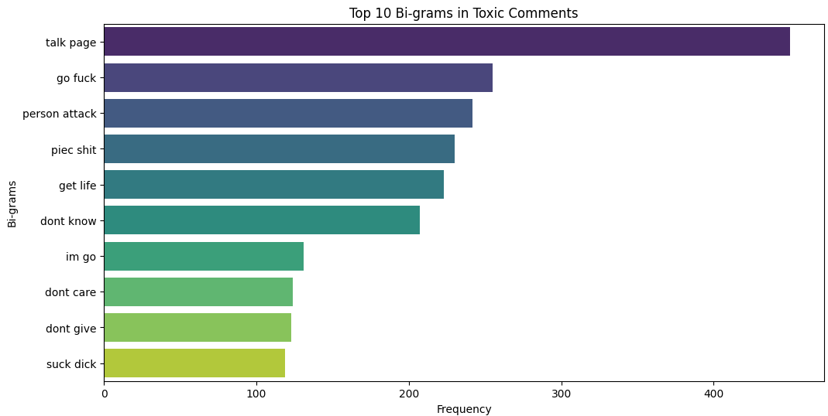
Exploratory Data Analysis

Slide 11
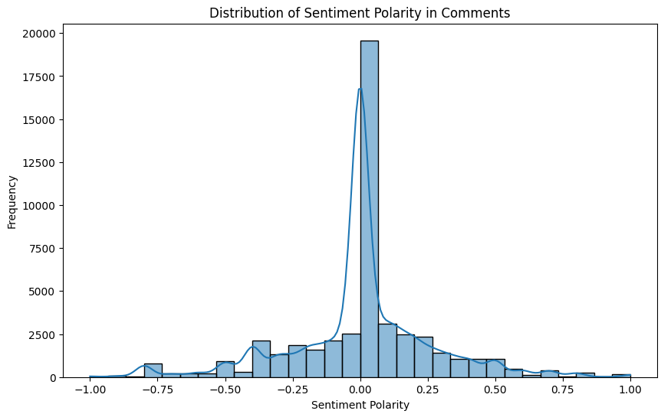
Exploratory Data Analysis

Slide 12
Model Development
Logistic Regression
Used default sigmoid logistic function.
Split the dataset - training and testing sets (80% training, 20% testing).
Scaled the TF-IDF features - StandardScaler.
Trained - 1000 iterations on the scaled features.
Made predictions on the test set using the trained model (logistic_model.predict).
Simplicity and interpretability.

Slide 13
Model Development
Sequential NN model
The Sequential Neural Network model:
Dense layers - starting with 256 neurons and ReLU activation
Dropout layer
Dense layer - 128 neurons and ReLU activation
Dropout layer
Dense layer - 1 neuron and sigmoid activation for binary classification.
Compiled using the Adam optimizer with a learning rate of 0.0001
Ability to capture complex patterns in sequential data like text. They excel in tasks where the order of input data matters, such as natural language processing.

Slide 14
Model Development
Support Vector Machine (SVM)
SVM finds the hyperplane that best separates the classes in the feature space. It maximizes the margin, i.e., the distance between the hyperplane and the nearest data points of each class, making it robust against overfitting.
SVM is selected for its ability to handle complex relationships in data, especially when using nonlinear kernels. It is effective in high-dimensional spaces and with datasets that have clear margin separation.
SVM is selected for its ability to handle complex relationships in data, especially when using nonlinear kernels. It is effective in high-dimensional spaces and with datasets

Slide 15
Model Development
Naive Bayes
Made use of Multinomial Naive Bayes classifier for classification.
It calculates the probability of each class given a set of input features using Bayes' theorem.
Naive Bayes is chosen for its simplicity and efficiency, especially with text classification tasks.

Slide 16
Feature Engineering
Feature engineering serves as a crucial phase in the model development process, enhancing both the interpretability and performance of the model.
Feature Engineering Techniques used in our analysis:
TF-IDF Vectorization: Transforming text into numerical representations, capturing word importance within documents.
Sentiment Analysis (TextBlob): Extracting sentiment polarity scores as features.
Utilizing Doc2Vec: Extending Word2Vec to capture semantic similarities and relationships at a document level.
Merged TF-IDF features, sentiment scores, and Doc2Vec vectors, to create a unified and comprehensive feature set.

Slide 17
Feature Engineering
Integration of Features:
Trained the models with only TF-IDF features first.
The two-step integration process.
First combining TF-IDF and sentiment polarity features.
Subsequently incorporating Doc2Vec vectors, allowing for an incremental exploration of feature interactions.
Combining these distinct types of features, the models gained the capability to leverage both lexical and semantic aspects.
The training of models at each stage provided insights into the impact of feature combinations on the accuracy and effectiveness for classification.

Slide 18
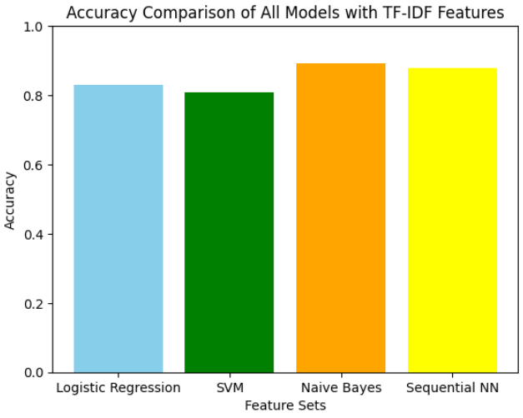
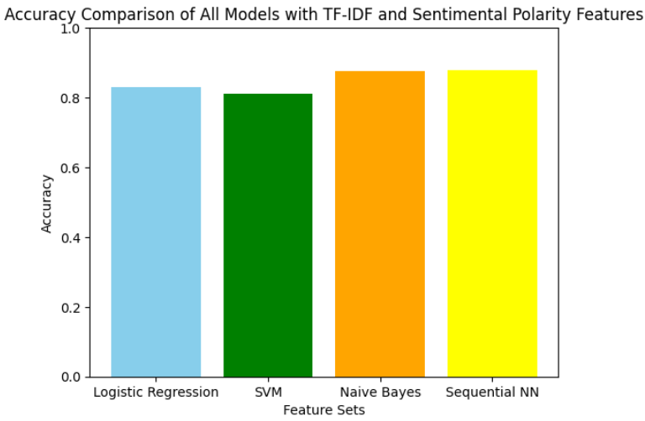
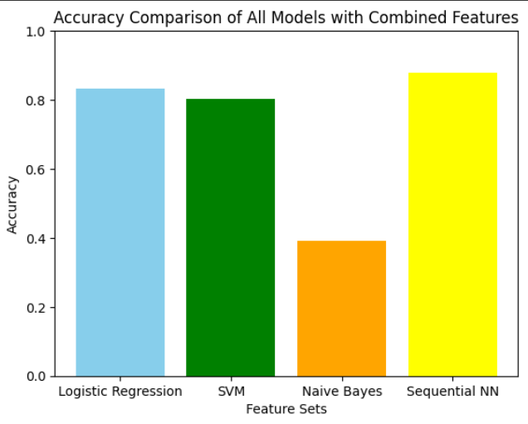
Feature Engineering
Comparing the results of featuring engineering

Slide 19
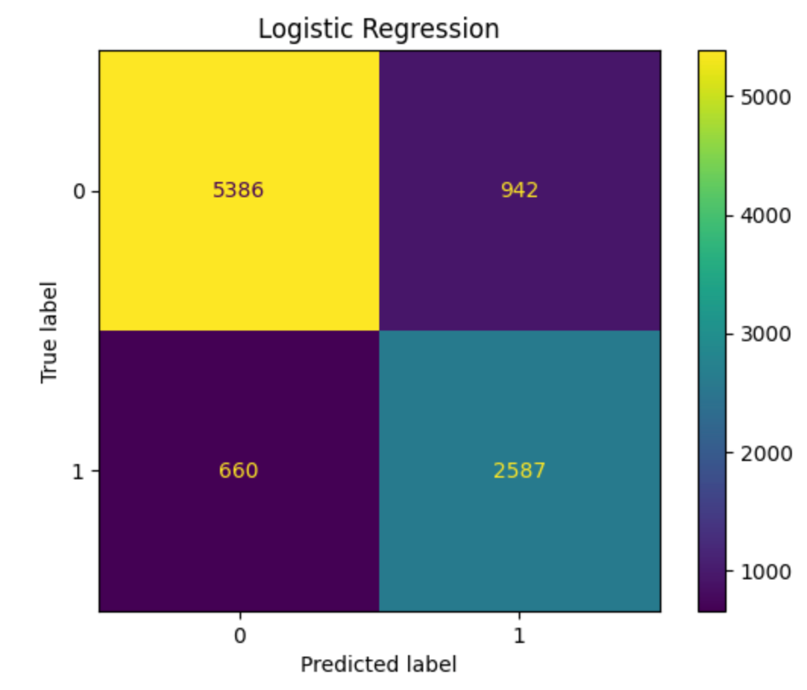
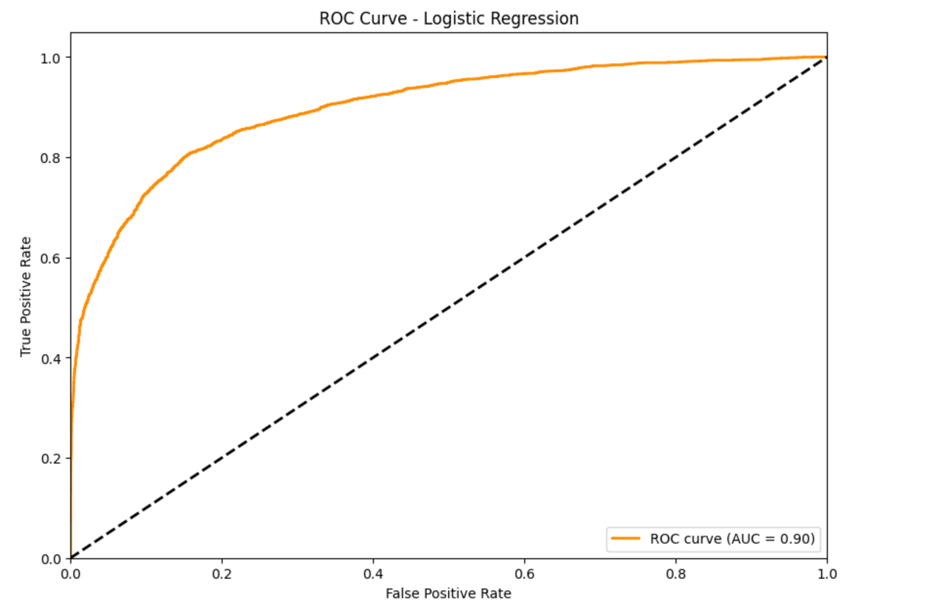
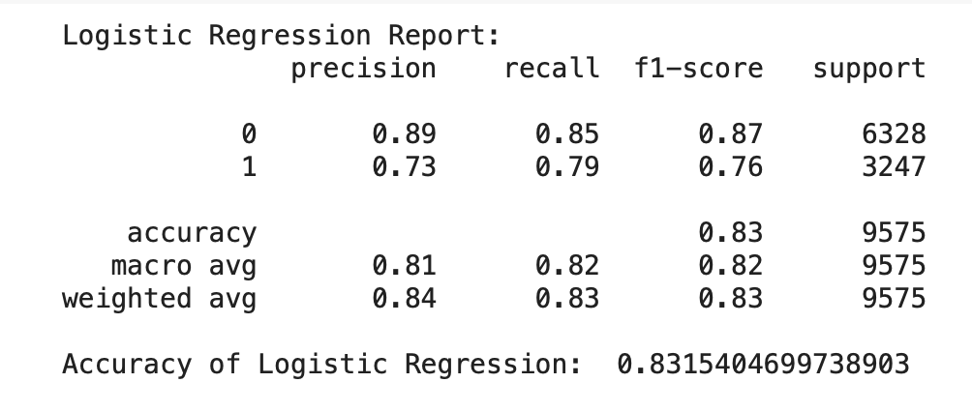
Model Evaluation
Logistic Regression

Slide 20
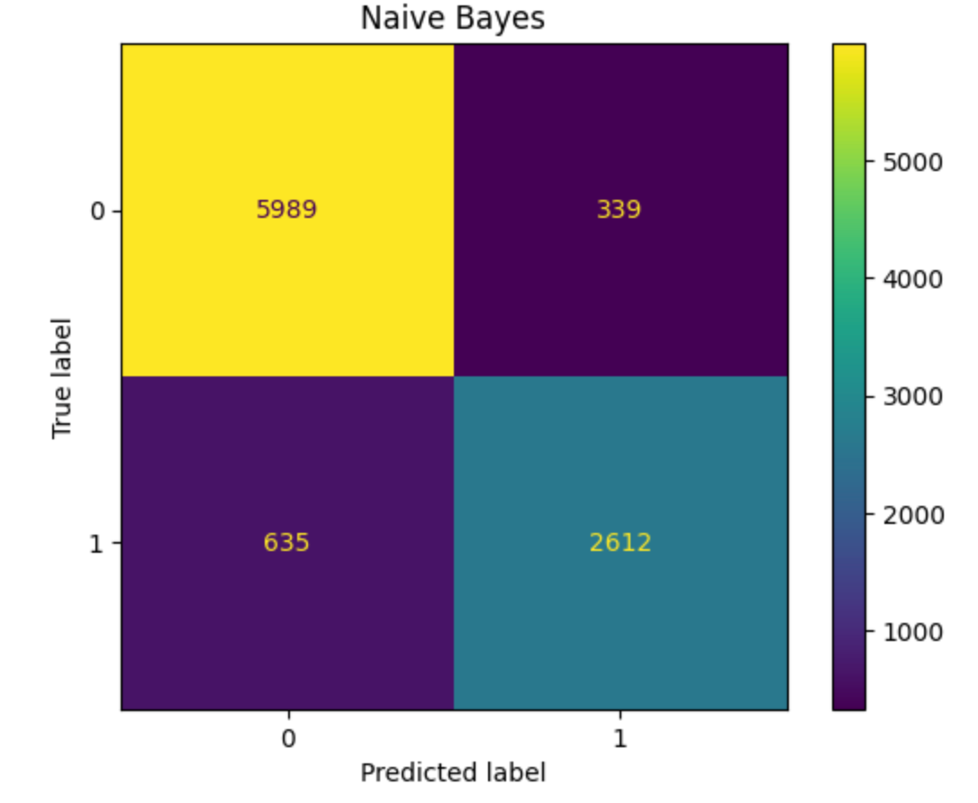
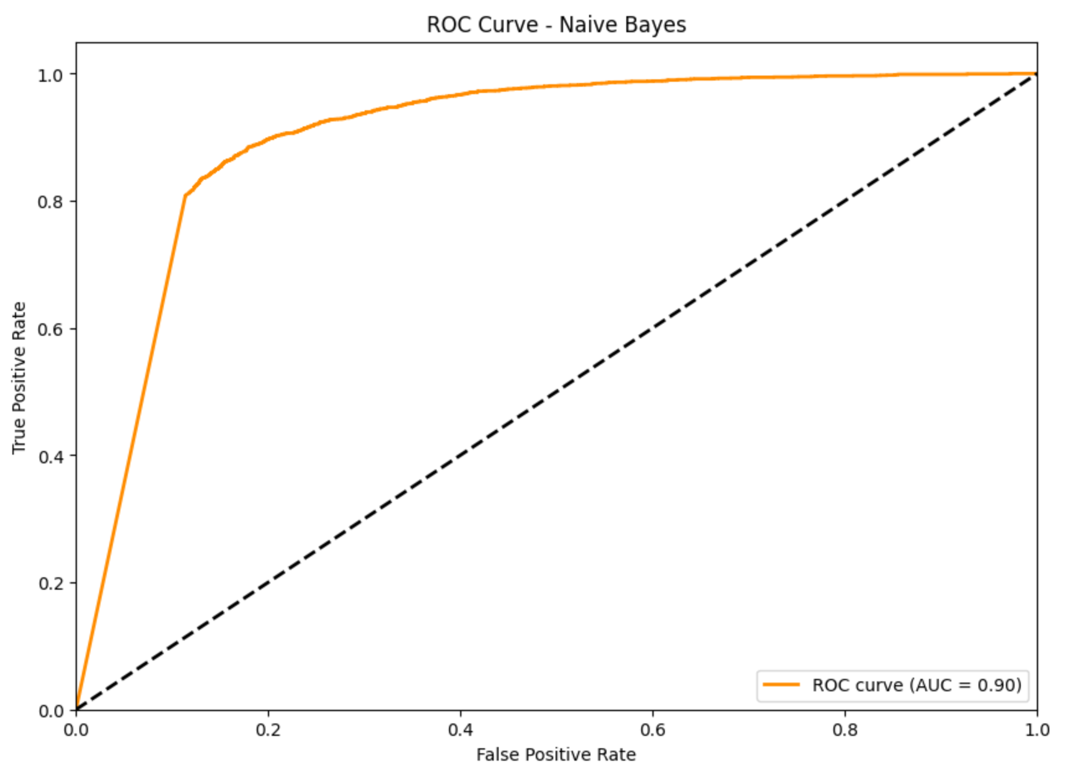
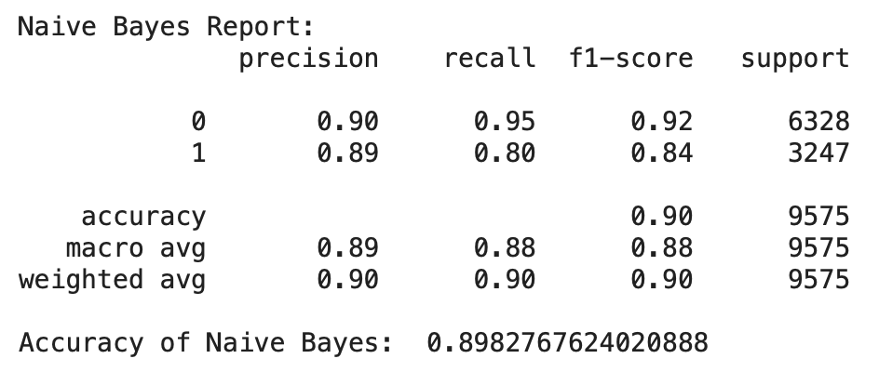
Model Evaluation
Naive Bayes

Slide 21
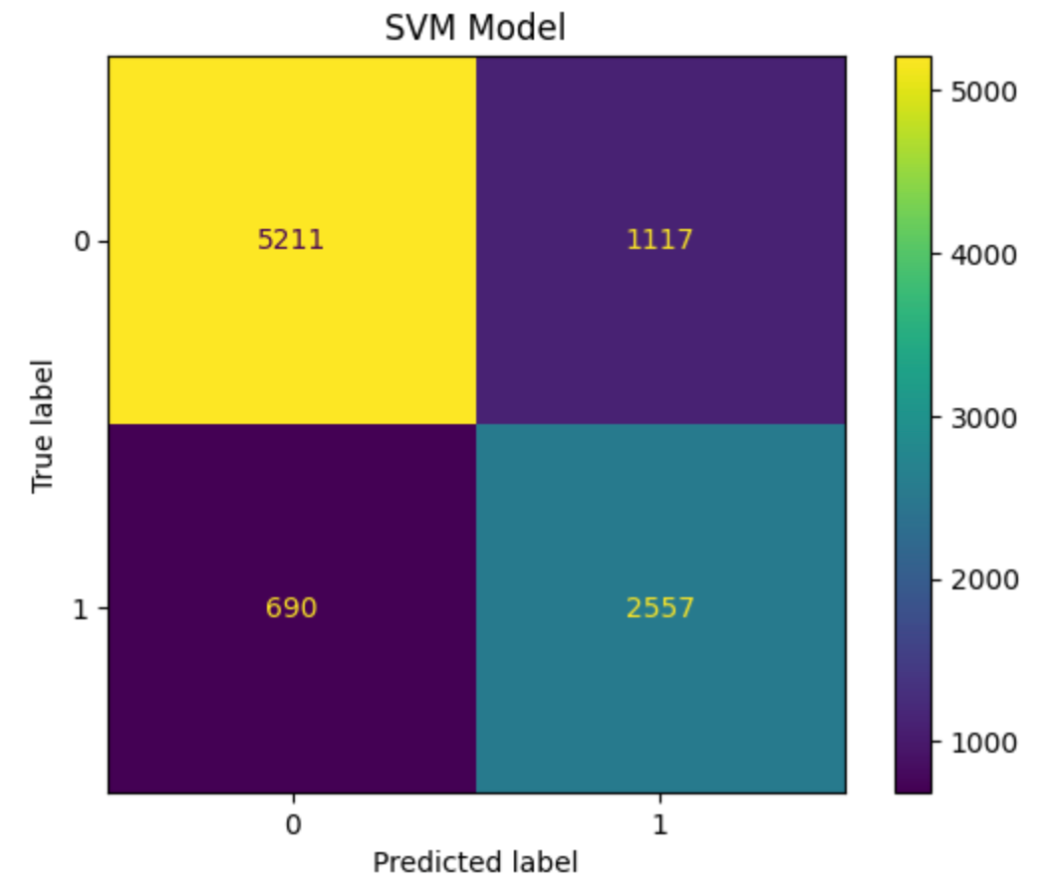
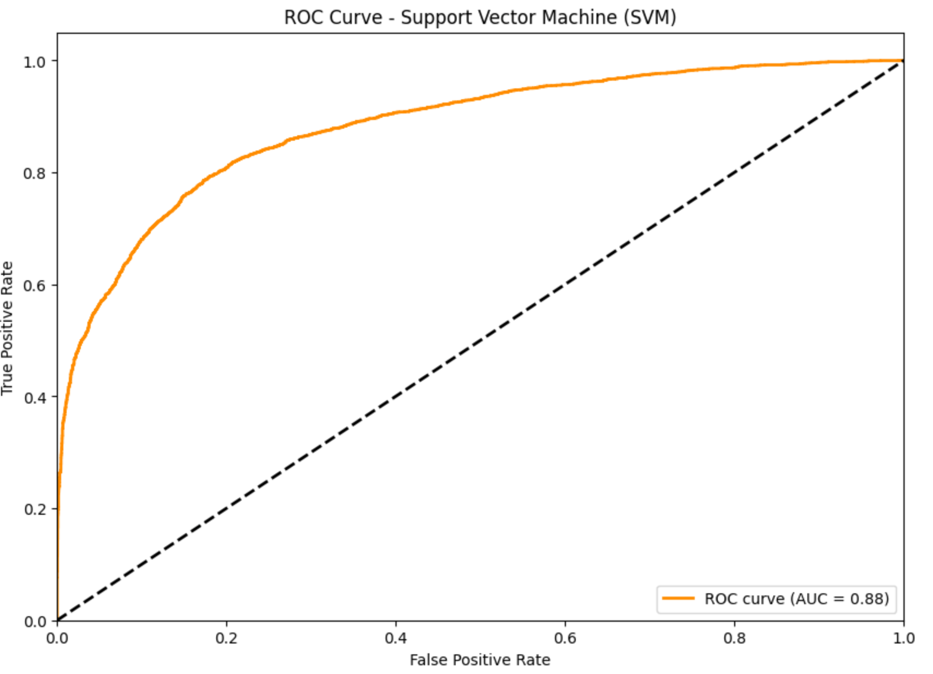
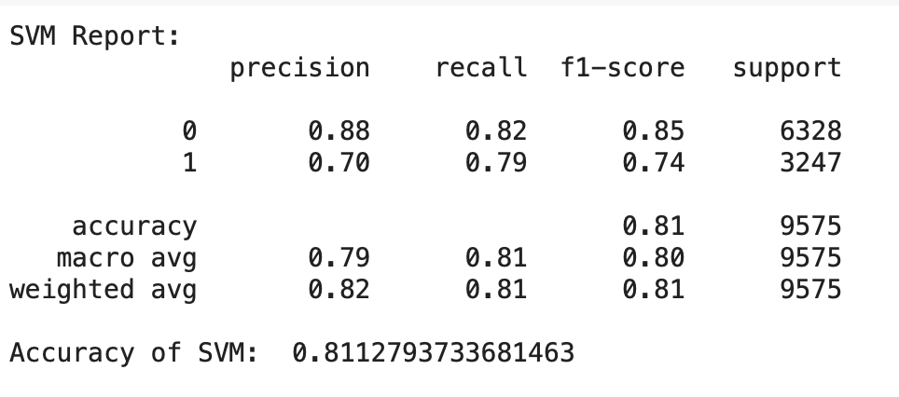
Model Evaluation
Support Vector Machine

Slide 22
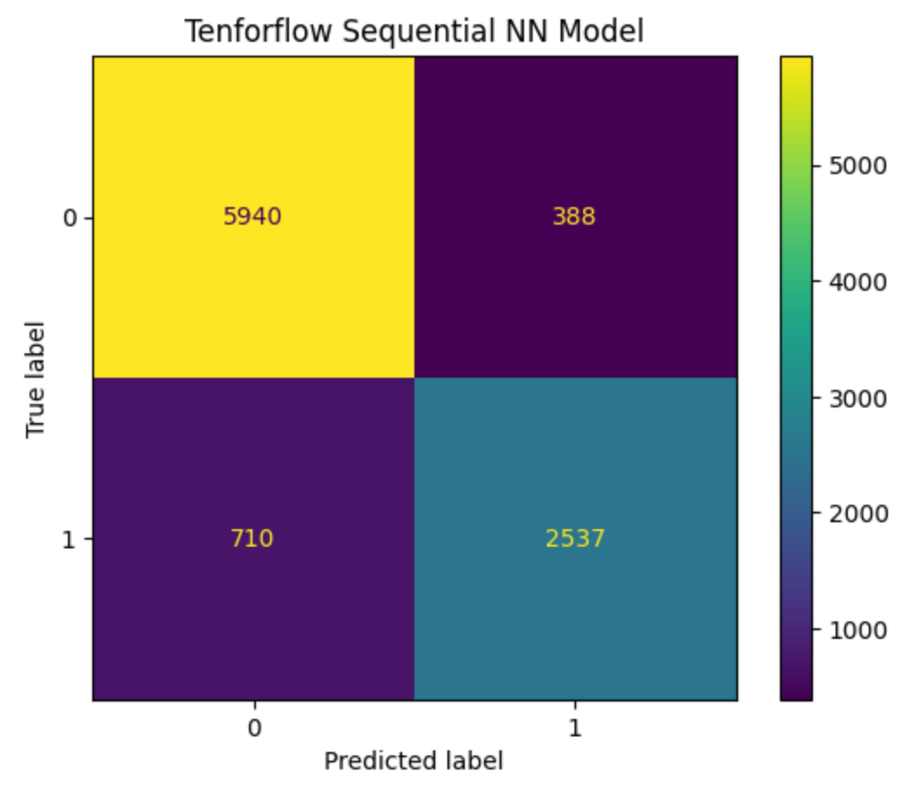
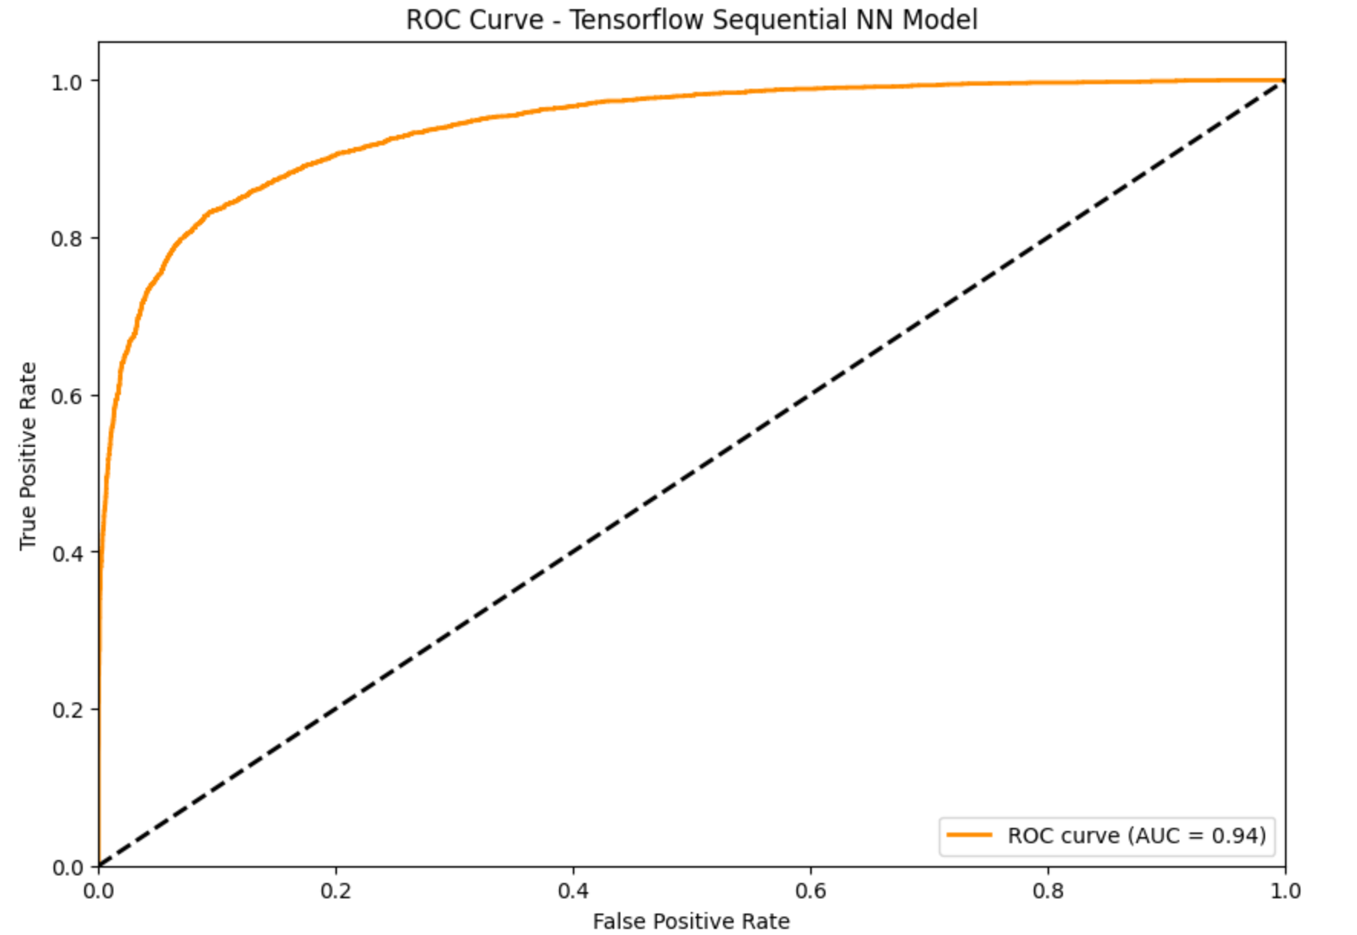
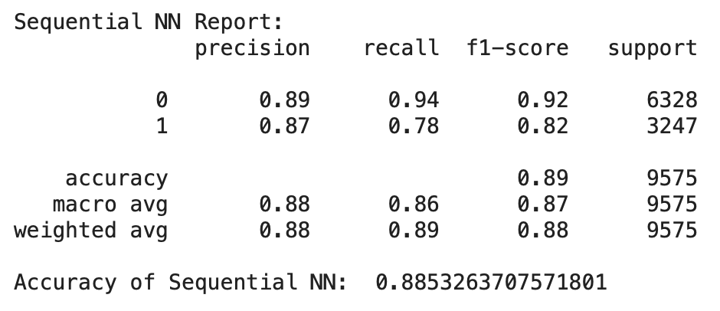
Model Evaluation
Tensorflow Sequential NN

Slide 23
Conclusion
Based on the comparison of different evaluation metrics, Naive Bayes is performing better than other model ( Precision, Recall, Accuracy ) minimizing false positives.
Based on the ROC curve and AUC, Tensorflow Sequential NN with AUC-0.94 is better than other models, better discrimination ability across different threshold.
While experimenting with different features, TF-IDF with Sentimental Polarity worked best with all the models in general.
Sequential Neural Network Model was better model among all when we incorporated all the different features together.
For future work, we discussed expanding the labeled dataset, adding user/network metadata features, using ensemble modeling, and deploying the model for real-time content moderation to further improve performance.

Slide 24
Thank You

